Slide 1


Effects of Sub-Atmospheric Pressures on the Temperature Evolution of Spark Kernels
Daniel Caplan and David Blunck, PhD.
Oregon State University
SciTech, 8-12 January 2018
Kissimmee, Florida

Slide 2
How is ignition studied?
Minimum Ignition Energy (MIE)
Spark Kernels
Reacting
Non-Reacting
Mathematical Modeling

Slide 3
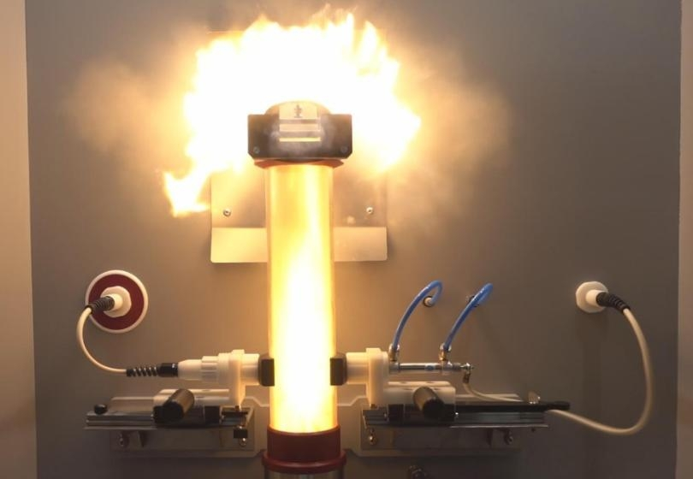
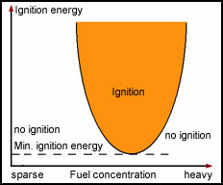
How is ignition studied?
Minimum Ignition Energy (MIE)

Slide 4
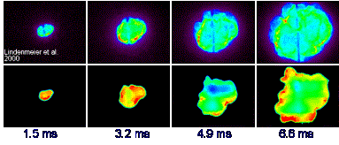
How is ignition studied?
Spark Kernels: Reacting
Upper: Chemiluminescence
Lower: OH* Laser Induced Fluorescence (LIF)
http://www.itt.kit.edu/english/323.php

Slide 5
How is ignition studied?
Spark Kernels: Non-Reacting
Schlieren image of kernels from Sforzo

Slide 6
How is ignition studied?
Spark Kernels: Mathematical Modeling
Model image of kernels from Sforzo

Slide 7



Slide 8
Presentation Title
Template is optional. Please note formatting guidelines below.
Landscape orientation
4:3 Ratio
Font
Sans serif (e.g. Arial, Tahoma)
Sized 24-40 points
Minimal information—highlight main points
No commercialism/advertising
Can your slides be easily read from 15 meters away?

